Slide 1
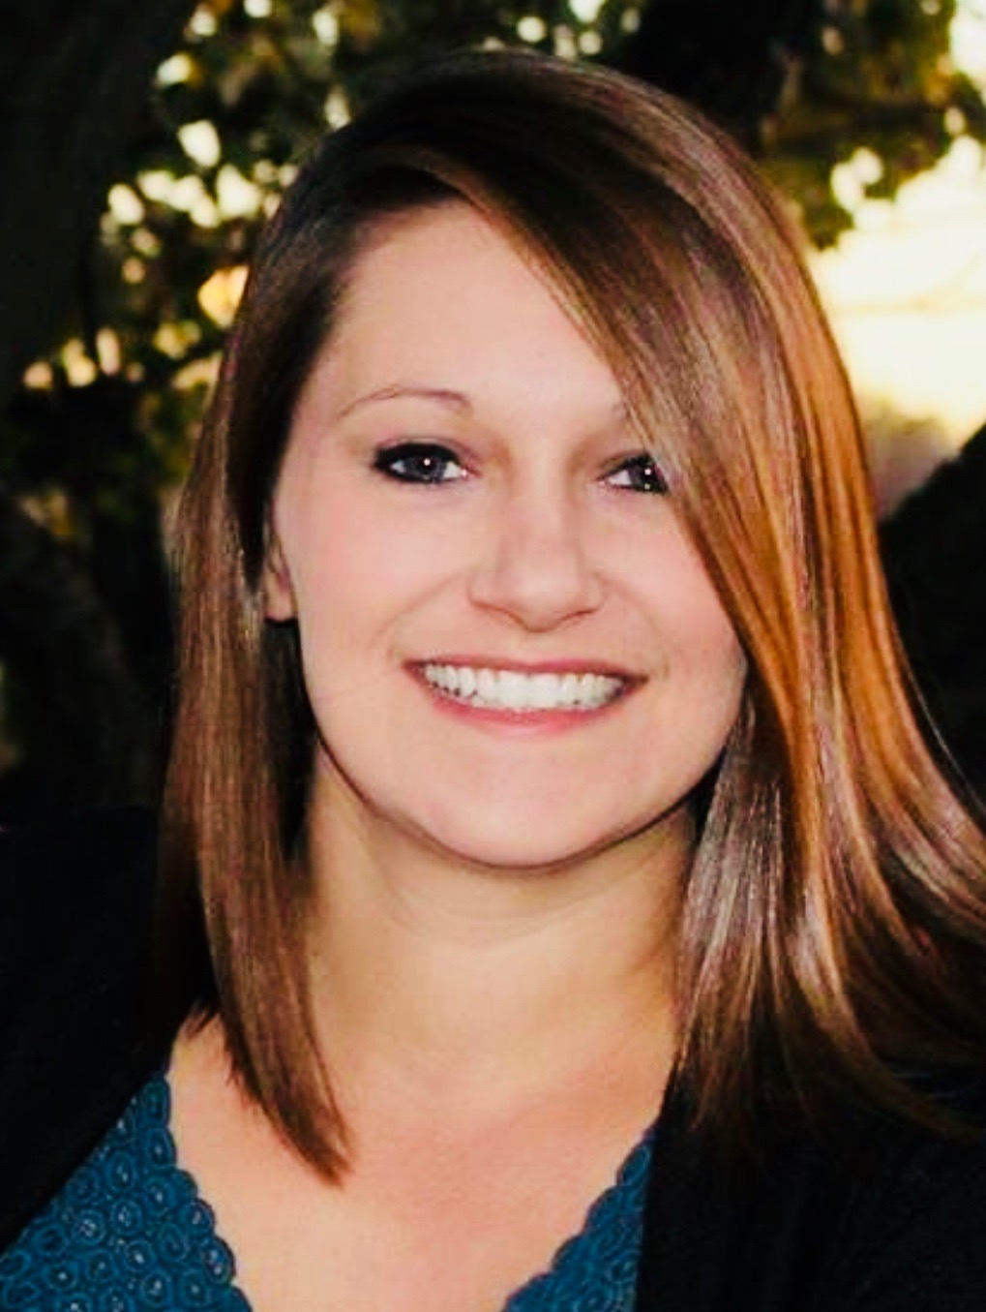
Hudson
Neighborhood Market Report | Q3 2019
13
55
11
Q2
homes sold in 2019
percent of homes sold above asking price in 2019
average days on the market in 2019
$258,000
average price in 2019
$25,000
Increase in average sales price from this time last year
*Statistics do not include Hudson Hills or rural homes
Karine Rastatter
Realtor®
Realty One Group Five Star
Phone: 303.990.4679
Email: karine@rogfivestar.com

